Slide 1
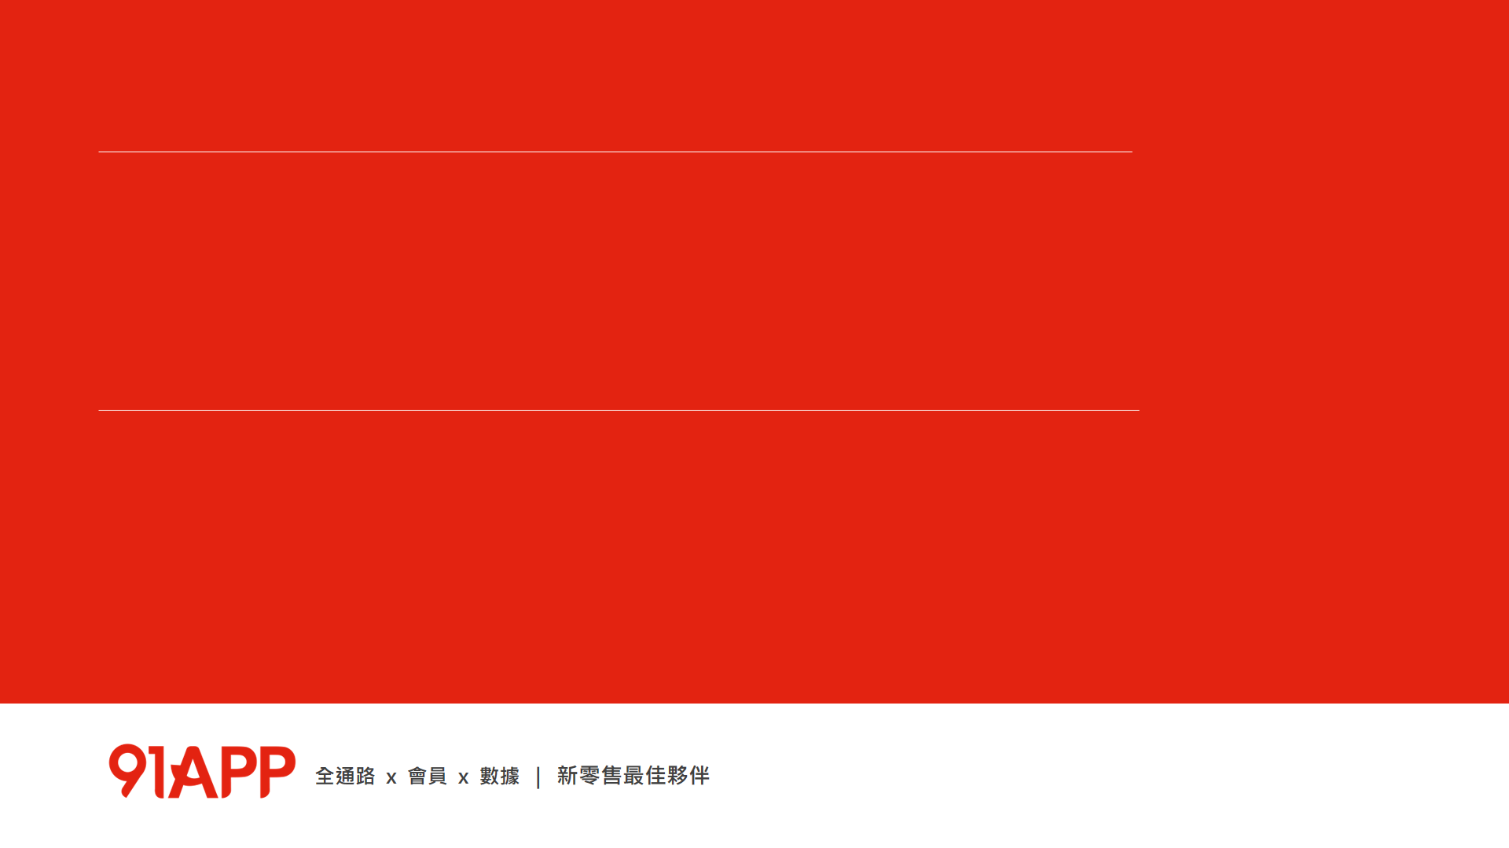

微服務基礎建設 – Message Queue
Andrew Wu, Chief Architect @ 91APP
Jan 28, 2019

Slide 2

Andrew Wu 是誰?
經歷: 91APP, Chief Architect
Microsoft MVP
資策會 雲端系列課程 Azure PaaS 講師
Microsoft Azure Cafe, TechDays, TechEd 講師
專欄作家
談論各種軟體開發與設計的大小事，有 20 年的大型與雲端服務的開發經驗。喜歡研究各種技術背後的原理與實作細節，期許自己做個優秀的架構師。研究主題以: .NET / C# / OOP / Container / Microservices / Distributed System 為主軸，同時在部落格上也持續分享相關主題的一系列文章。期許能將這些領域的實作經驗分享到社群。

Slide 3
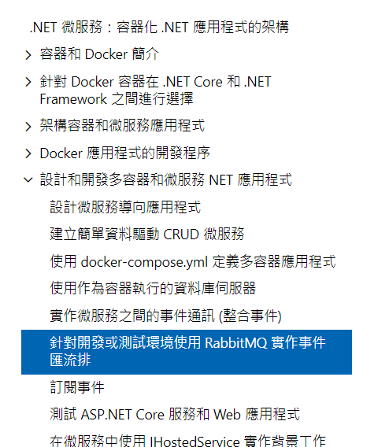
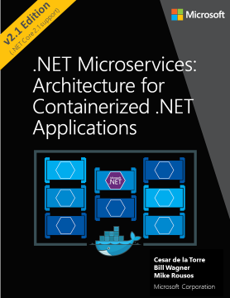
.NET Microservices

Slide 4
AGENDA
Message Queue Concepts
NineYi.Msa.Infra.Messaging.*
Inside Messaging:
Thread Sync Basic
Graceful Shutdown
Auto Scaling In Infra Way, Not In Developer Way
Demo & QA
Notes:
課程目標: 讓 server group developer 了解 “如何使用” MessageClient / MessageWorker
了解怎麼用的同時，能理解背後設計理念，甚至進一步了解該怎麼設計這樣的元件給團隊使用的技巧。
架構性的思考: 專注再要解決的問題，不重新發明 framework, 盡可能地用基礎元件 (如 language 內建的 BCL), 讓 developer team 能套用在自己的框架內使用。
替團隊做好抽象畫 (不綁定特定 services), 及整合其他環節。這是團隊自行開發，而非專注再選擇 framework 的主要原因。

Slide 5
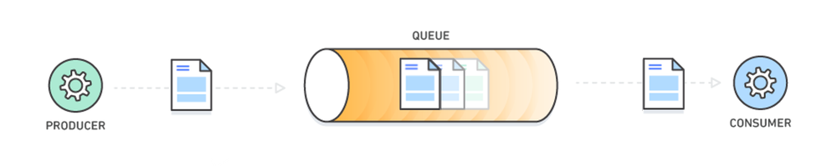
What is a Message Queue?
https://aws.amazon.com/message-queue/
Notes:
Notes:
Cloud Service / Cloud native / Container / Microservices ….
線上服務的複雜度越來越高，服務數量變多，服務的 instance 也變多
管理的挑戰也變大

Slide 6
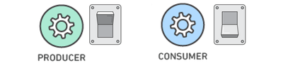
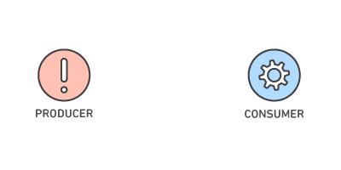
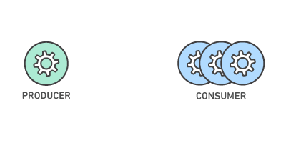
Benefits of Message Queues
Better Performance
Increased Reliability
Granular Scalability
Asynchronous communication, optimizing data flow.
Consumers process messages only when they are available.
Queues make your data persistent, and reduce the errors
that happen when different parts of your system go offline.
Message queues make it possible to scale precisely where
you need to. Producers, consumers and the queue itself can
all grow and shrink on demand.
https://aws.amazon.com/message-queue/benefits/
Notes:
Granular 粒狀的

Slide 7
Benefits of Message Queues
Simplified Decoupling
Break Up Apps
Migrate to Microservices
Shift to Serverless
Message queues remove dependencies between components and significantly simplify
the coding of decoupled applications. Message queues are an elegantly simple way to decouple
distributed systems, whether you're using monolithic applications, microservices or serverless architectures.
Microservices integration patterns that are based on events and asynchronous messaging
optimize scalability and resiliency. Use message queuing services to coordinate multiple
microservices, notify microservices of data changes, or as an event firehose to process IoT,
social and real-time data.

Slide 8
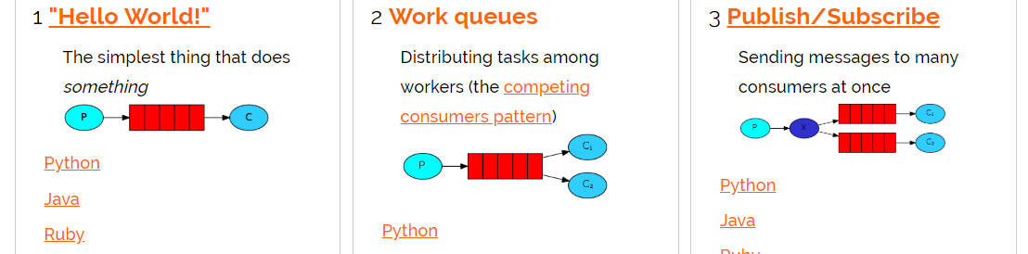
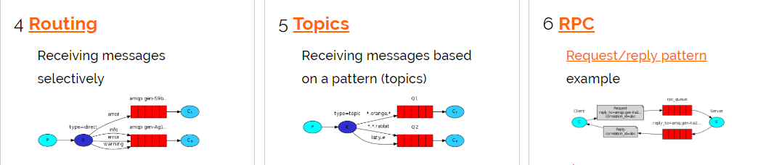
Rabbit MQ: Queue + Exchange
http://www.rabbitmq.com/getstarted.html

Slide 9
First Looks Of:
NineYi.Msa.Infra.Messaging.*

Slide 10
Design Goal
隱藏不必要的彈性
充分運用 C# 的語意，最小化自訂介面
充分整合 91APP 的系統架構
整合 Track Context
整合 Microsoft.Extensions.DependencyInjection
整合 Logger*, Configuration* … etc
充分整合 Infra, 降低 Ops 的負擔
https://docs.microsoft.com/sk-sk/dotnet/standard/design-guidelines/index

Slide 11
Design Concept (One-Way Async)
Track Context {
RequestId,
SessionId,
MemberId,
ShopId
}
Track Context {
RequestId,
SessionId,
MemberId,
ShopId
}
MessageClient<Message>
MessageWorker<Message>
Serialization Data Of Message
TrackContext Transform

Slide 12
Design Concept (Two-Way RPC)
MessageClient<Input, Output>
MessageWorker<Input, Output>
Serialization Data Of InputMessage
Serialization Data Of OutputMessage

Slide 13
除了這些，其他都抽象化封裝起來…
Developer Must Know:
Input Message
Output Message
Worker Process (msg) => { … }
Misc:
Multi-Threads
Async / Await
Serialization, TrackContext Transform
Notes:
除了數量之外，複雜度也隨之升高。
每個服務 (service) 及每個個體 (instance) 都必須更精準的掌握其他服務的狀態 (availability, endpoitns)
服務之間的通訊也越來越複雜

Slide 14
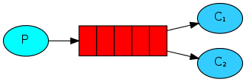
DEMO #1
Basic Work Queue(s) with TrackContext

Slide 15
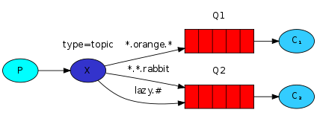
DEMO #1
Exchange Usage: Topic

Slide 16
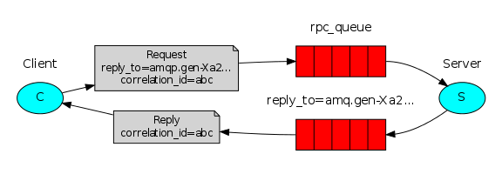
DEMO #2
RPC: Remote Procedure Call
http://www.rabbitmq.com/tutorials/tutorial-six-dotnet.html

Slide 17
Inside Messaging.*

Slide 18
What Architect Thinks…
Async (use Notify, not Pooling)
Parallel Processing for Best Performance
Inside Worker – threading, synchronize
Outside Worker – scaling out, using multiple VMs
Design for Operation
graceful shutdown & auto scaling

Slide 19
Demo #3 Synchronization Basic, Async & WaitHandle
ThreadSyncDemo, AsyncDemo

Slide 20
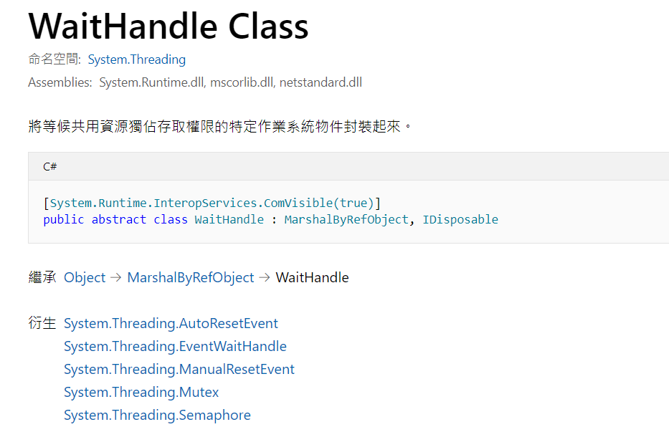
Synchronize Basic:
https://docs.microsoft.com/zh-tw/dotnet/api/system.threading.waithandle?view=netframework-4.7.2

Slide 21
Async / Await
Wrap Async Call In Separate Process…
Inside .NET Async & Await
Inside .NET Thread Sync
Notes:
DEMO worker thread count effect
DEMO manual / auto reset event

Slide 22
return worker’s Task
call worker
start await
await complete
caller
A(5)
C(5)
E(10)
worker
B(3)
D(10)
?
clock
0
5
8
13
18+?
28+?

Slide 23
Demo #4 Support Graceful Shutdown
Scaling (Use Docker-Compose)

Slide 24
Auto Scaling In Infra Way
Basic Concept: Scale In / Out Automation
Your Application Must (when Scale Out):
Self Host
Pull Config
Pull Message
Your Application Must (when Scale In):
Handle OS Shutdown Event / Signal
Do Graceful Shutdown

Slide 25
Graceful Shutdown
When VM / Container Being Shutdown…
{
Receive OS shutdown signal
Stop Receive Newer Message
Wait Until All Messages Ack
Exit Process Normally
}
Successful Shutdown VM / Container

Slide 26
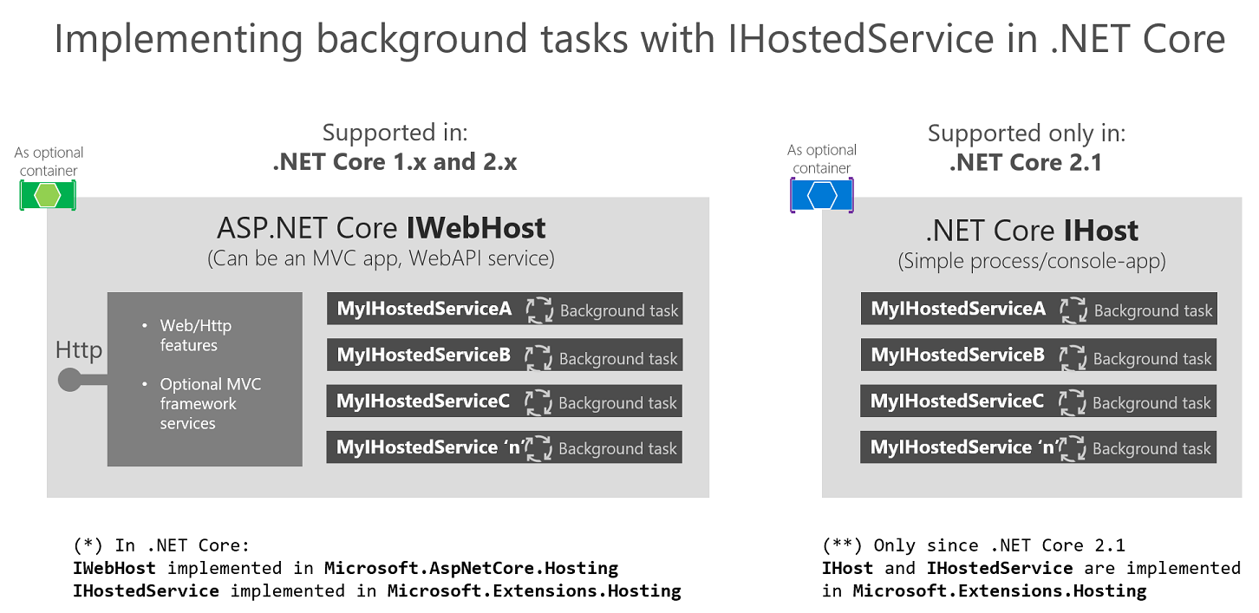

Slide 27
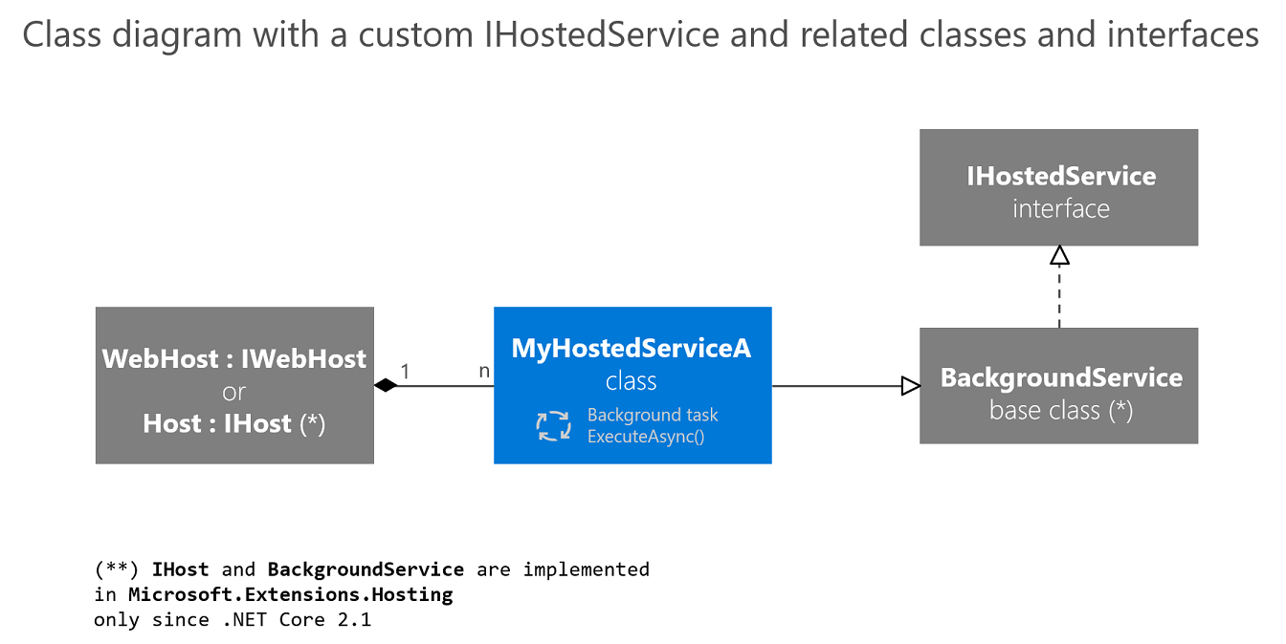

Slide 28
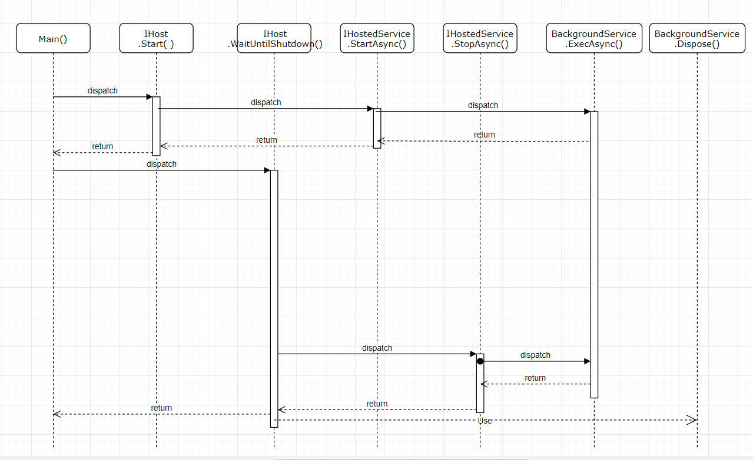
first await
wait shutdown signal
do graceful shutdown

Slide 29
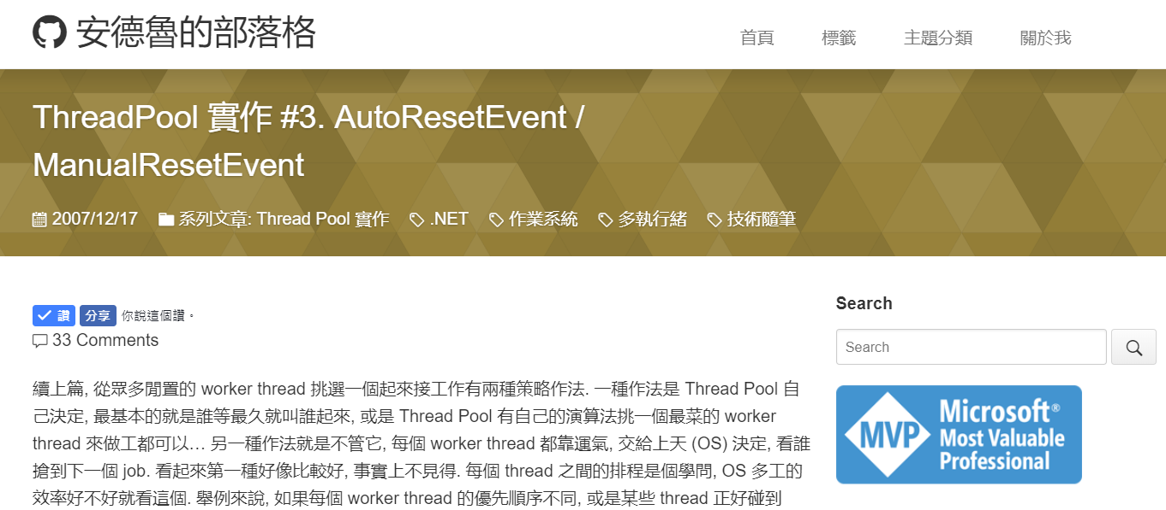
What Is “AutoResetEvent” ?
https://columns.chicken-house.net/2007/12/17/threadpool-%E5%AF%A6%E4%BD%9C-3-autoresetevent-manualresetevent/

Slide 30
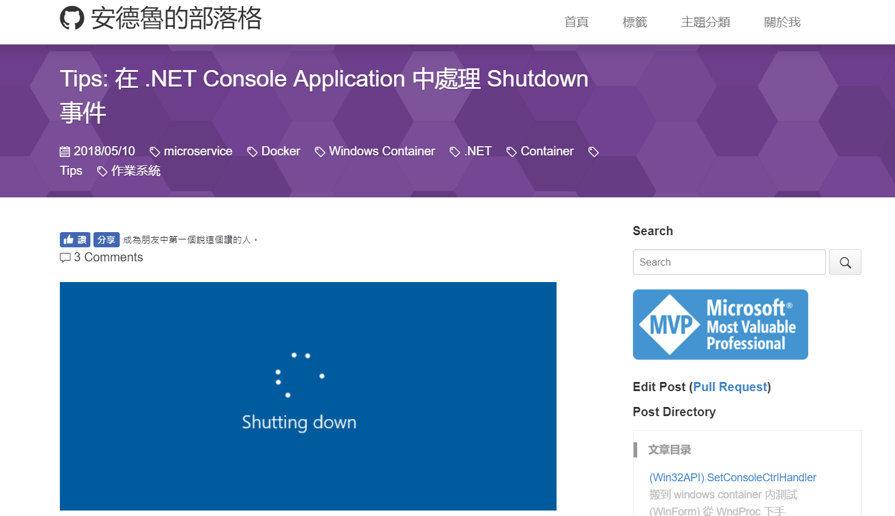
Tips: 如何處理 Windows 關機事件?
https://columns.chicken-house.net/2018/05/10/tips-handle-shutdown-event/

Slide 31
Question?

Slide 32

活動滿意度問卷

Slide 33
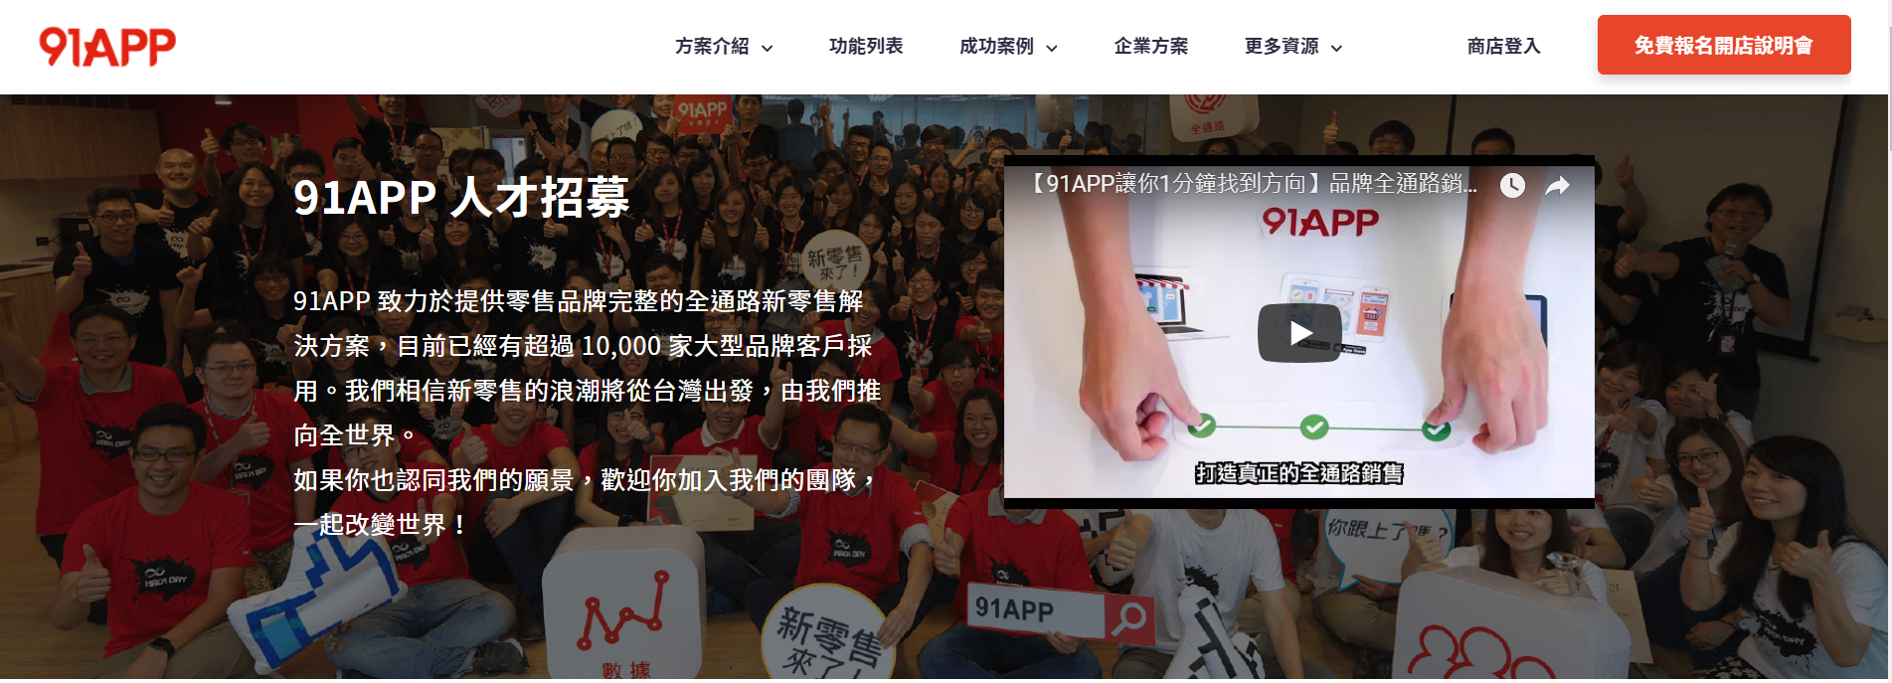
【我們正在招募】
● 架構師
● C# Asp.Net MVC開發工程師
https://www.91app.com/careers/

Slide 34



新零售就要Line一起
~~現在就加入~~
* 技術課程&講座優先報名 *
* 講師簡報獨家提供 *
* 新零售市場訊息搶先報 *

